Slide 1
Chapter 7:-
NETWORK SECURITY
Compiled By:- Akash Mehta
GIT.

Slide 2
Outline
Digital Signatures
Authentication Protocols
Digital Signature Standards
Application Authentication Techniques Like Kerberos
X.509 Directory
Authentication Services
Active Directory Service Of Windows NT/Windows 2000
Akash Mehta

Slide 3
Digital Signatures
Digital signatures provide the ability to:
  verify author, date & time of signature
  authenticate message contents
  be verified by third parties to resolve disputes
Akash Mehta
Notes:
The most important development from the work on public-key cryptography is the digital signature. Message authentication protects two parties who exchange messages from any third party. However, it does not protect the two parties against each other. A digital signature is analogous to the handwritten signature, and provides a set of security capabilities that would be difficult to implement in any other way. It must have the following properties:
• It must verify the author and the date and time of the signature
• It must to authenticate the contents at the time of the signature
• It must be verifiable by third parties,to resolve disputes
Thus, the digital signature function includes the authentication function.

Slide 4
Digital Signature Properties
must depend on the message signed
must use information unique to sender
  to prevent both forgery and denial
must be relatively easy to produce
must be relatively easy to recognize & verify
be computationally infeasible to forge
be practical save digital signature in storage
Akash Mehta
Notes:
On the basis of the properties on the previous slide, we can formulate the requirements for a digital signature as shown. A variety of approaches has been proposed for the digital signature function. These approaches fall into two categories: direct and arbitrated.

Slide 5
Digital Signature
Categories of Digital Signature:
  Direct
  Arbitrated.
Akash Mehta

Slide 6
Direct Digital Signatures
involve only sender & receiver
assumed receiver has sender’s public-key
digital signature made by sender signing entire message or hash with private-key
can encrypt using receivers public-key
important that sign first then encrypt message & signature
security depends on sender’s private-key
Akash Mehta
Notes:
Direct Digital Signatures involve the direct application of public-key algorithms involving only the communicating parties. A digital signature may be formed by encrypting the entire message with the sender’s private key, or by encrypting a hash code of the message with the sender’s private key. Confidentiality can be provided by further encrypting the entire message plus signature using either public or private key schemes. It is important to perform the signature function first and then an outer confidentiality function, since in case of dispute, some third party must view the message and its signature. But these approaches are dependent on the security of the sender’s private-key. Will have problems if it is lost/stolen and signatures forged. Need time-stamps and timely key revocation.

Slide 7

Direct Digital Signature
Confidentiality, Authentication & Digital Signature
Akash Mehta

Slide 8
Weakness of Direct D.S
The validity of the scheme depends on the security of the sender's private key.
If a sender later wishes to deny sending a particular message, the sender can claim that the private key was lost or stolen and that someone else forged his or her signature.
One example is to require every signed message to include a timestamp (date and time) and to require prompt reporting of compromised keys to a central authority.
Akash Mehta

Slide 9
Arbitrated Digital Signatures
involves use of arbiter A
  validates any signed message
  then dated and sent to recipient
requires suitable level of trust in arbiter
can be implemented with either private or public-key algorithms
arbiter may or may not be able to see message
Akash Mehta
Notes:
The problems associated with direct digital signatures can be addressed by using an arbiter, in a variety of possible arrangements, as shown in Stallings Table 13.1.
The arbiter plays a sensitive and crucial role in this sort of scheme, and all parties must have a great deal of trust that the arbitration mechanism is working properly.
These schemes can be implemented with either private or public-key algorithms, and the arbiter may or may not see the actual message contents.

Slide 10
Authentication Protocols
used to convince parties of each others identity and to exchange session keys
may be One-way or Mutual
key issues are
  confidentiality – to protect session keys
  timeliness – to prevent replay attacks
published protocols are often found to have flaws and need to be modified
Akash Mehta
Notes:
Authentication Protocols are used to convince parties of each others identity and to exchange session keys. They may be one-way or mutual.
Central to the problem of authenticated key exchange are two issues: confidentiality and timeliness. To prevent masquerade and to prevent compromise of session keys, essential identification and session key information must be communicated in encrypted form. This requires the prior existence of secret or public keys that can be used for this purpose. The second issue, timeliness, is important because of the threat of message replays.
Stallings discusses a number of protocols that appeared secure but were revised after additional analysis. These examples highlight the difficulty of getting things right in the area of authentication.

Slide 11
(Mutual Authentication) Replay Attacks
where a valid signed message is copied and later resent
  Simple replay: The opponent simply copies a message and replays it later.
  Repetition that can be logged: An opponent can replay a timestamped message within the valid time window
  Repetition that cannot be detected: This situation could arise because the original message could have been suppressed and thus did not arrive at its destination; only the replay message arrives
  Backward replay without modification: This is a replay back to the message sender.
Akash Mehta
Notes:
Replay Attacks are where a valid signed message is copied and later resent. Such replays, at worst, could allow an opponent to compromise a session key or successfully impersonate another party. At minimum, a successful replay can disrupt operations by presenting parties with messages that appear genuine but are not.
[GONG93] lists the examples above of replay attacks.
Possible countermeasures include the use of:
• sequence numbers (generally impractical since must remember last number used with every communicating party)
• timestamps (needs synchronized clocks amongst all parties involved, which can be problematic)
• challenge/response (using unique, random, unpredictable nonce, but not suitable for connectionless applications because of handshake overhead)

Slide 12
Countermeasures to avoid Replay Attack
Timestamps (needs synchronized clocks)
  Party A accepts a message as fresh only if the message contains a timestamp that, in A's judgment, is close enough to A's knowledge of current time. This approach requires that clocks among the various participants be synchronized.
Challenge/response (using unique nonce)
  Party A, expecting a fresh message from B, first sends B a nonce (challenge) and requires that the subsequent message (response) received from B contain the correct nonce value.
Akash Mehta

Slide 13
Using Symmetric Encryption
as discussed previously, we can use a two-level hierarchy of keys
usually with a trusted Key Distribution Center (KDC)
  each party shares own master key with KDC
  KDC generates session keys used for connections between parties
  master keys used to distribute these to them
Akash Mehta
Notes:
A two-level hierarchy of symmetric encryption keys can be used to provide confidentiality for communication in a distributed environment.
Usually involves the use of a trusted key distribution center (KDC). Each party in the network shares a secret master key with the KDC. The KDC is responsible for generating session keys, and for distributing those keys to the parties involved, using the master keys to protect these session keys.

Slide 14
Needham-Schroeder Protocol
original third-party key distribution protocol
for session between A B mediated by KDC
protocol overview is:
  1. A->KDC: ID_{A} || ID_{B} || N₁
  2. KDC -> A: E_{Ka}[Ks || ID_{B} || N₁ || E_{Kb}[Ks||ID_{A}] ]
  3. A -> B: E_{Kb}[Ks||ID_{A}]
  4. B -> A: E_{Ks}[N₂]
  5. A -> B: E_{Ks}[f(N₂)]
Akash Mehta
Notes:
The Needham-Schroeder Protocol is the original, basic key exchange protocol. Used by 2 parties who both trusted a common key server, it gives one party the info needed to establish a session key with the other. Note that since the key server chooses the session key, it is capable of reading/forging any messages between A&B, which is why they need to trust it absolutely!
Note that all communications is between A&KDC and A&B, B&KDC don't talk directly (though indirectly a message passes from KDC via A to B, encrypted in B's key so that A is unable to read or alter it). Other variations of key distribution protocols can involve direct communications between B&KDC.

Slide 15
Needham-Schroeder Protocol
used to securely distribute a new session key for communications between A & B
but is vulnerable to a replay attack if an old session key has been compromised
Akash Mehta
Notes:
There is a critical flaw in the protocol, as shown. It can be corrected by either using timestamps, or an additional nonce, with respective advantages and limitations.
This example emphasises the need to be extremely careful in codifying assumptions, and tracking the timeliness of the flow of info in protocols. Designing secure protocols is not easy, and should not be done lightly. Great care and analysis is needed.

Slide 16
Using Public-Key Encryption
have a range of approaches based on the use of public-key encryption
need to ensure have correct public keys for other parties
using a central Authentication Server (AS)
various protocols exist using timestamps or nonces
Akash Mehta
Notes:
Have a range of approaches based on the use of public-key encryption, which generally assume that each of the two parties is in possession of the current public key of the other. The central system is known as an Authentication Server (AS). Have various protocols using timestamps or nonces, and again flaws were found in a number of the original proposals. See text for details.

Slide 17
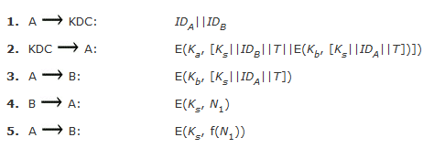
Denning AS Protocol
Denning 81 presented the following:
timestamps prevent replay but require synchronized clocks
Akash Mehta
Notes:
A protocol using timestamps is provided in [DENN81] is shown above. The central authentication server (AS) only provides public-key certificates. The session key is chosen and encrypted by A; hence, there is no risk of exposure by the AS. The timestamps protect against replays of compromised keys. This protocol is compact but, as before, requires synchronization of clocks.

Slide 18
One-Way Authentication
required when sender & receiver are not in communications at same time (e.g., email)
have header in clear so can be delivered by email system
Akash Mehta
Notes:
One application for which encryption is growing in popularity is electronic mail (e-mail). The very nature of electronic mail, and its chief benefit, is that it is not necessary for the sender and receiver to be online at the same time. Instead, the e-mail message is forwarded to the receiver’s electronic mailbox,where it is buffered until the receiver is available to read it. The “envelope” or header of the e-mail message must be in the clear so that the message can be handled by the store-and-forward e-mail protocol. However it is often desirable that e-mail message be encrypted such that the mail-handling system is not in possession of the decryption key. A second requirement is that of authentication, where the recipient wants some assurance that the message is from the alleged sender. One-Way Authentication addresses these requirements.

Slide 19
Using Symmetric Encryption
can refine use of KDC but can’t have final exchange of nonces:
  1. A->KDC: ID_{A} || ID_{B} || N₁
  2. KDC -> A: E_{Ka}[Ks || ID_{B} || N₁ || E_{Kb}[Ks||ID_{A}] ]
  3. A -> B: E_{Kb}[Ks||ID_{A}] || E_{Ks}[M]
does not protect against replays
  could rely on timestamp in message, though email delays make this problematic
Akash Mehta
Notes:
Using symmetric encryption, with some refinement, the KDC strategy is a candidate for encrypted electronic mail. Because we wish to avoid requiring that the recipient be on line at the same time as the sender, steps 4 and 5 must be eliminated, leaving the protocol as shown.
This approach guarantees that only the intended recipient of a message will be able to read I, and also provides a level of authentication that the sender is A. As specified, the protocol does not protect against replays. You could rely on timestamp in the message, though email delays make this problematic.

Slide 20
Public-Key Approaches
have seen some public-key approaches
if confidentiality is major concern, can use:
  A->B: E_{PUb}[Ks] || E_{Ks}[M]
  has encrypted session key, encrypted message
if authentication needed, use a digital signature with a digital certificate:
  A->B: M || E_{PRa}[H(M)] || E_{PRas}[T||ID_{A}||PU_{a}]
  with message, signature, certificate
Akash Mehta
Notes:
Have already presented public-key encryption approaches that are suited to electronic mail, including the straight forward encryption of the entire message for confidentiality, authentication, or both. These approaches require that either the sender know the recipient’s public key (confidentiality) or the recipient know the sender’s public key (authentication) or both (confidentiality plus authentication). In addition, the public-key algorithm must be applied once or twice to what may be a long message.
If confidentiality is the primary concern, then the message can be encrypted with a one-time secret key, which in in turn is encrypted with B’s public key.
To achieve authentication, and to validate the senders public key, the signature can be encrypted with the recipient’s public key, and for assurance A’s public key is sent in a digital certificate, as shown. To obtain confidentiality as well, the message can be encrypted with a session key, combining both options above.

Slide 21
Digital Signature Standard (DSS)
US Govt approved signature scheme
designed by NIST & NSA in early 90's
published as FIPS-186 in 1991
revised in 1993, 1996 & then 2000
uses the SHA hash algorithm
DSS is the standard, DSA is the algorithm
FIPS 186-2 (2000) includes alternative RSA & elliptic curve signature variants
Akash Mehta
Notes:
DSA is the US Govt approved signature scheme, which is designed to provide strong signatures without allowing easy use for encryption. The DSS makes use of the Secure Hash Algorithm (SHA), and presents a new digital signature technique, the Digital Signature Algorithm (DSA). The DSS was originally proposed in 1991 and revised in 1993 in response to public feedback concerning the security of the scheme. There was a further minor revision in 1996. In 2000, an expanded version of the standard was issued as FIPS 186-2, which incorporates digital signature algorithms based on RSA and on elliptic curve cryptography.

Slide 22
Digital Signature Algorithm (DSA)
creates a 320 bit signature
with 512-1024 bit security
smaller and faster than RSA
a digital signature scheme only
security depends on difficulty of computing discrete logarithms
Akash Mehta
Notes:
Will discuss the original DSS algorithm. The DSA signature scheme has advantages, being both smaller (320 vs 1024bit) and faster (much of the computation is done modulo a 160 bit number), over RSA. Unlike RSA, it cannot be used for encryption or key exchange. Nevertheless, it is a public-key technique. The DSA is based on the difficulty of computing discrete logarithms, and is based on schemes originally presented by ElGamal [ELGA85] and Schnorr [SCHN91].

Slide 23
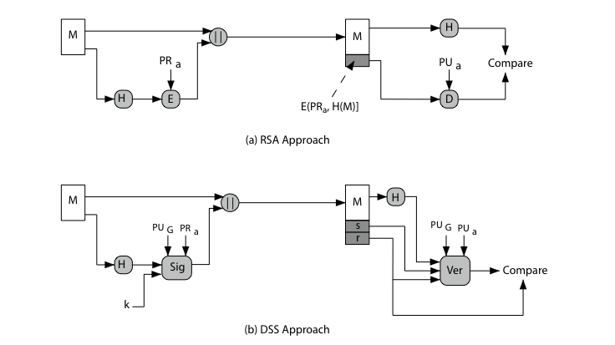
Digital Signature Algorithm (DSA)
Akash Mehta
Notes:
DSA differs from RSA in how the message signature is generated and validated, as shown in Stallings Figure 13.1.
RSA signatures encrypt the message hash with the private key to create a signature, which is then verified by being decrypted with the public key to compare to a recreated hash value.
DSA signatures use the message hash, global public values, private key & random k to create a 2 part signature (s,r). This is verified by computing a function of the message hash, public key, r and s, and comparing the result with r. The proof that this works is complex, but it achieves its aims!

Slide 24
DSA Signature Creation
to sign a message M the sender:
  generates a random signature key k, k<q
  k must be random, be destroyed after use, and never be reused
then compute signature pair:
  r = (g^{k}(mod p))(mod q)
  s = (k⁻¹.H(M)+ x.r)(mod q)
sends signature (r,s) with message M
Akash Mehta
Notes:
To create a signature, a user calculates two quantities, r and s, that are functions of the public key components (p,q,g), the user’s private key (x), the hash code of the message H(M), and an additional integer k that should be generated randomly or pseudo-randomly and be unique for each signing. This is similar to ElGamal signatures, with the use of a per message temporary signature key k, but doing calculations first mod p, then mod q to reduce the size of the result. The signature (r,s) is then sent with the message to the recipient. Note that computing r only involves calculation mod p and does not depend on message, hence can be done in advance. Similarly with randomly choosing k’s and computing their inverses.

Slide 25
Authentication Applications
developed to support application-level authentication & digital signatures
will discuss Kerberos – a private-key authentication service
discuss X.509 - a public-key directory authentication service
Akash Mehta
Notes:
This chapter examines some of the authentication functions that have been developed to support application-level authentication and digital signatures.
Will first look at one of the earliest and most widely used services: Kerberos. Then examine the X.509 directory authentication service.

Slide 26
Kerberos
Authentication service developed as a part of MIT’s Athena project
provides centralized private-key third-party authentication in a distributed network
  allows users access to services distributed through network
  without needing to trust all workstations
  rather all trust a central authentication server
two versions in use: 4 & 5
Akash Mehta
Notes:
Kerberos is an authentication service developed as part of Project Athena at MIT, and is one of the best known and most widely implemented trusted third party key distribution systems.
Kerberos provides a centralized authentication server whose function is to authenticate users to servers and servers to users. Unlike most other authentication schemes, Kerberos relies exclusively on symmetric encryption, making no use of public-key encryption. Two versions of Kerberos are in common use: v4 & v5.

Slide 27
Why Kerberos is needed ?
Problem: Not trusted workstation to identify
their users correctly in an open distributed environment
3 Threats:
  Pretending to be another user from the workstation
  Sending request from the impersonated workstation
  Replay attack to gain service or disrupt operations
Akash Mehta

Slide 28
Why Kerberos is needed ? Cont.
Solution:
  Building elaborate authentication protocols at each server
  A centralized authentication server (Kerberos)
Akash Mehta

Slide 29
Requirements for KERBEROS
Secure:
  An opponent does not find it to be the weak link
Reliable:
  The system should be able to back up another
Transparent:
  An user should not be aware of authentication
Scalable:
  The system supports large number of clients and severs
Akash Mehta
Notes:
31/03/2005

Slide 30
Versions of KERBEROS
Two versions are in common use
  Version 4 is most widely used version
  Version 4 uses of DES
  Version 5 corrects some of the security deficiencies of Version 4
  Version 5 has been issued as a draft Internet Standard (RFC 1510)
Akash Mehta

Slide 31
Kerberos v4 Overview
a basic third-party authentication scheme
have an Authentication Server (AS)
  users initially negotiate with AS to identify self
  AS provides a non-corruptible authentication credential (ticket granting ticket TGT)
have a Ticket Granting server (TGS)
  users subsequently request access to other services from TGS on basis of users TGT
Akash Mehta
Notes:
The core of Kerberos is the Authentication and Ticket Granting Servers – these are trusted by all users and servers and must be securely administered. The protocol includes a sequence of interactions between the client, AS, TGT and desired server.

Slide 32
Kerberos v4 Dialogue
obtain ticket granting ticket from AS
  once per session
obtain service granting ticket from TGT
  for each distinct service required
client/server exchange to obtain service
  on every service request
Akash Mehta
Notes:
The full Kerberos v4 authentication dialogue is shown in Stallings Table 14.1, divided into the 3 phases shown above. The justification for each item in the messages is given in Stallings Table 14.2.

Slide 33
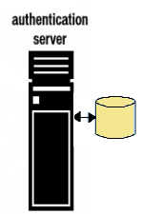


Kerberos Version 4: Dialog 1- Simple
Pc=password of client
1- IDc + Pc+IDv
2- Ticket
3- IDc +Ticket
kv=Secret Key between AS and V (Server)
Ticket=Ekv[IDc,ADc,IDv]
Akash Mehta

Slide 34
where
C= client
AS= authentication server
V=server
ID_{C}= identifier of user on C
ID_{V}= identifier of V
P_{C}= password of user on C
AD_{C}= network address of C
K_{v}= secret encryption key shared by AS and V
Akash Mehta

Slide 35
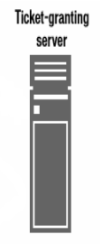
Kerberos Version 4 : Dialog 2-More Secure
ticketTGS=EKtgs[IDc,ADc,
IDtgs,TS1,LifeTime1 ]
Once per user logon session
1- IDc + IDtgs
Once per type of service
2- EKc [TicketTGS]
3- TicketTGS+IDc+IDv
4-TicketV
Akash Mehta

Slide 36
Kerberos Version 4 : Dialog 2
- More Secure Cont.
Once per service session
5- TicketV+ IDc
TicketV=EKv[IDc,ADc,IDv,Ts2,Lifetime2]
Akash Mehta

Slide 37
Kerberos: The Version 4 Authentication Dialog
Once per user logon session
KERBEROS
ticketTGS=EKtgs [Kc.tgs, IDc,ADc,IDtgs,TS2, LifeTime2 ]
1- IDc + IDtgs +TS1
2- EKc [Kc.tgs,IDtgs,Ts2,
Lifetime2,TicketTGS]
Akash Mehta

Slide 38
Kerberos: The Version 4 Authentication Dialog Cont.
Once per type of service
KERBEROS
ticketTGS=EKtgs [Kc.tgs,IDc,ADc,IDtgs, TS2, LifeTime2 ]
AuthenticatorC=EKc.tgs[IDc,ADc,TS3]
ticketV=EKV[Kc.v,IDc,ADc,IDv, TS4, LifeTime4 ]
3- TicketTGS + AuthenticatorC + IDv
4-EKc.tgs[ Kc.v,IDv,Ts4,Ticketv]
Akash Mehta

Slide 39
Kerberos: The Version 4 Authentication Dialog Cont.
Once per service session
5- TicketV+ AuthenticatorC
6- EKc.v[TS5+1]
TicketV=EKv [Kv.c, IDc, ADc, IDv, TS4, Lifetime4]
AuthenticatorC=EKc.v [IDc,ADc,TS5]
Akash Mehta

Slide 40
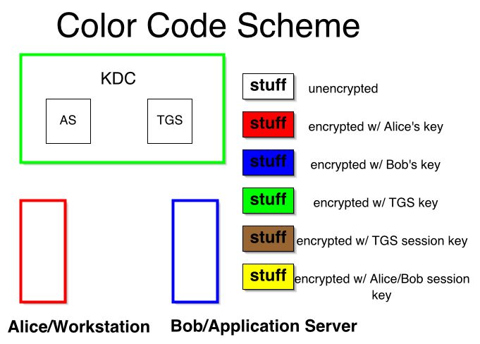
Overview of Kerberos: 1
Akash Mehta

Slide 41
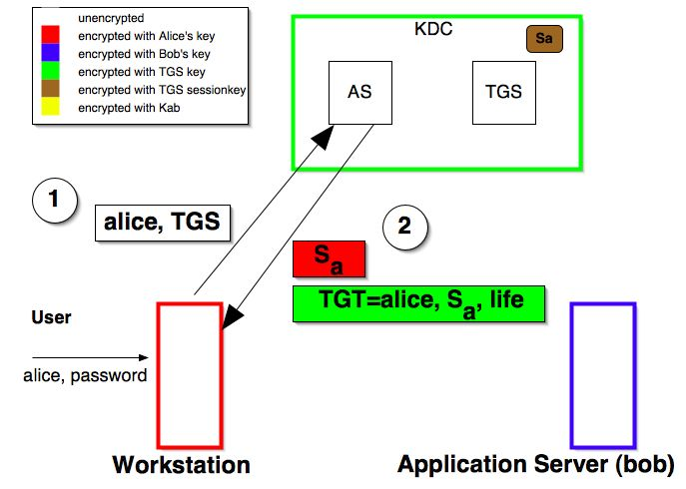
Overview of Kerberos: 2
Akash Mehta

Slide 42
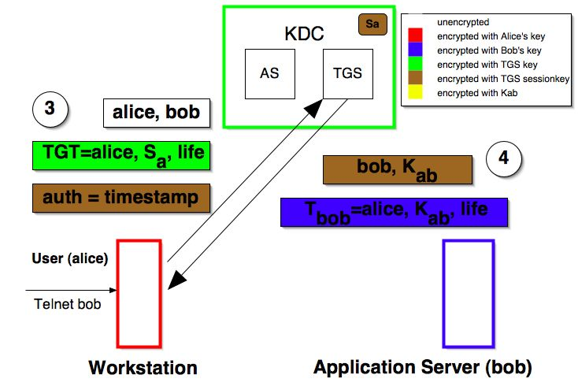
Overview of Kerberos: 3
Akash Mehta

Slide 43
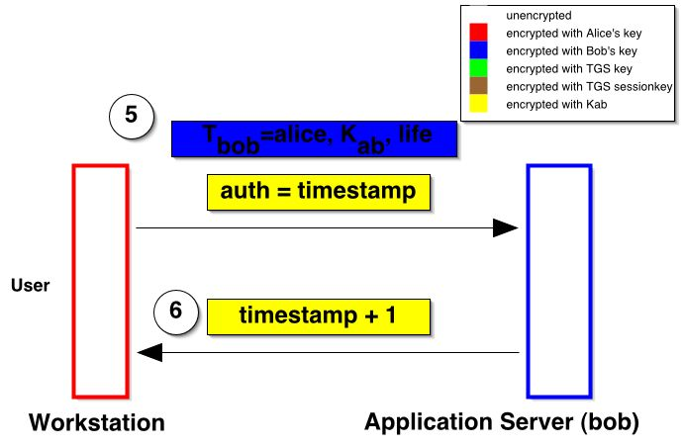
Overview of Kerberos: 4
Akash Mehta

Slide 44
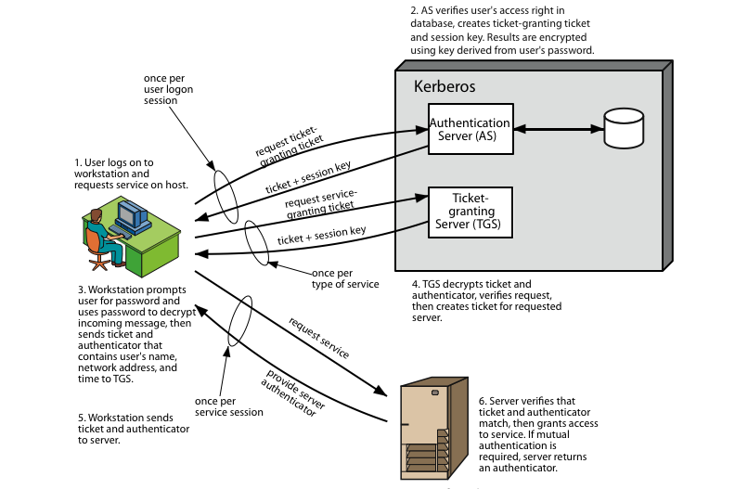
Kerberos 4 Overview
Akash Mehta
Notes:
Stallings Figure 14.1 diagrammatically summarizes the Kerberos v4 authentication dialogue, with 3 pairs of messages, for each phase listed previously.

Slide 45
Tickets:
Contains information which must be considered private to the user
Allows user to use a service or to access TGS
Reusable for a period of particular time
Used for distribution of keys securely
Akash Mehta

Slide 46
Authenticators
Proves the client’s identity
Proves that user knows the session key
Prevents replay attack
Used only once and has a very short life time
One authenticator is typically built per session of use of a service
Akash Mehta

Slide 47
Kerberos Realms
A single administrative domain includes:
  a Kerberos server
  a number of clients, all registered with server
  application servers, sharing keys with server
What will happen when users in one realm need access to service from other realms?:
  Kerberos provide inter-realm authentication
Akash Mehta

Slide 48
Inter-realm Authentication:
Kerberos server in each realm shares a secret key with other realms.
It requires
  Kerberos server in one realm should trust the one in other realm to authenticate its users
  The second also trusts the Kerberos server in the first realm
Problem: N*(N-1)/2 secure key exchange
Akash Mehta

Slide 49
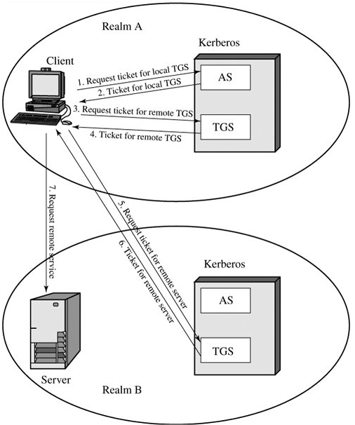
Request for Service in another realm:
Akash Mehta

Slide 50
KERBEROS Version 5 versus Version4
Environmental shortcomings of Version 4:
  Encryption system dependence: DES
  Internet protocol dependence
  Ticket lifetime
  Authentication forwarding
  Inter-realm authentication
Akash Mehta

Slide 51
KERBEROS Version 5 versus Version4
Technical deficiencies of Version 4:
  Double encryption
  Session Keys
  Password attack
Akash Mehta

Slide 52
New Elements in Kerberos Version 5
Realm
  Indicates realm of the user
Options
Times
  From: the desired start time for the ticket
  Till: the requested expiration time
  Rtime: requested renew-till time
Nonce
  A random value to assure the response is fresh
Akash Mehta

Slide 53
Kerberos Version 5 Message Exchange:1
To obtain ticket-granting ticket:
(1)C → AS : Options || IDc || Realmc || IDtgs ||Times ||
Nonce1
(2) AS → C : Realmc || IDc || Ticket tgs ||
EKc [ Kc,tgs || IDtgs || Times || Nonce1 ||| Realm tgs ]
Ticket tgs= EKtgs [ Flags || Kc,tgs || Realm c ||
IDc || ADc || Times]
Akash Mehta

Slide 54
Kerberos Version 5 Message Exchange:2
To obtain service-granting ticket :
(3)C → TGS : Options || IDv || Times || Nonce2 || Ticket tgs ║
Authenticator c
(4)TGS → C : Realmc || IDc || Ticket v || EK c,tgs [ Kc,v ║Times||
Nonce2 || IDv ║ Realm v]
Ticket tgs= EKtgs [ Flags || Kc,tgs || Realm c || IDc || ADc ||
Times]
Ticket v : EK v [Kc,,v ║ Realmc || IDc ║ ADc ║ Times ]
Authenticator c : EK c,tgs [IDc ║ Realmc ║ TS1]
Akash Mehta

Slide 55
Kerberos Version 5 Message Exchange:3
To obtain service
(5) C → S : Options || Ticket v|| Authenticator c
(6) S → C : EK c,v [TS2|| Subkey || Seq# ]
Ticket v : EK v [Flags || Kc,v || Realmc ||
IDc || ADc || Times ]
Authenticator c : EK c,v [IDc || Realmc ||
TS2 || Subkey|| Seq# ]
Akash Mehta

Slide 56
Kerberos : Strengths
User's passwords are never sent across the network, encrypted or in plain text
Secret keys are only passed across the network in encrypted form
Client and server systems mutually authenticate
It limits the duration of their users' authentication.
Authentications are reusable and durable
Kerberos has been scrutinized by many of the top programmers, cryptologists and security experts in the industry
Akash Mehta

Slide 57
Certificate:
Electronic counterparts to driver licenses, passports
Verifies authenticity of the public key
Prevents impersonation
Enables individuals and organizations to secure business and personal transactions
Akash Mehta
Notes:
31/03/2005

Slide 58
What a certificate includes:
Name of Entity being Certified
Public Key
Name of Certificate Authority
Serial Number
Expiration Date
Digital signature of the issuer
Other information (optional)
Akash Mehta

Slide 59
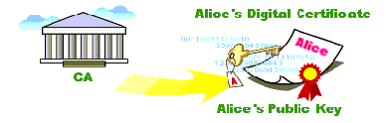
Certificate Authorities:
Trusted entity which issue and manage certificates for a population of public-private key-pair holders.
A digital certificate is issued by a CA and is signed with CA’s private key.
Akash Mehta

Slide 60
Who are the Certificate Authorities?
VeriSign
GTE CyberTrust
Entrust
IBM
CertCo
USPS / Cylink
Akash Mehta

Slide 61
Certificate Issuance Process:
Generate public/private key pair
Sends public key to CA
Proves identity to CA - verify
CA signs and issues certificate
CA e-mails certificate or Requestor retrieves certificate from secure websites
Requestor uses certificate to demonstrate legitimacy of their public key
Akash Mehta

Slide 62
Types of Digital Certificates
E-Mail Certificates
Browser Certificates
Server (SSL) Certificates
Software Signing Certificates
Akash Mehta
Notes:
31/03/2005

Slide 63
Potential security holes:
Was the user really identified?
Security of the private key
Can the Certificate Authority be trusted?
Names are not unique
Akash Mehta

Slide 64
X.509 Directory Authentication Service
Defines a framework for the authentication services
The X.509 directory serving as a repository of public-key certificates
Defines alternative authentication protocols
Akash Mehta

Slide 65
X.509 Certificate format
Version
Serial number
Algorithm Parameters
Issuer
Not before Not after
Subject
Algorithm Parameter Key
Signature
Notation to define a certificate:
Algorithm
identifier
CA<<A>>=CA{V,SN,AI,CA,Ta,A,Ap}
where
Y<<X>>= the certificate of user X issued by certification authority Y
Y{I}=the signing of I by Y. It consists of I with an enciphered hash code appended.
Period of
validity
Subject’s
public key
Akash Mehta

Slide 66
Securely Obtain a Public Key
Scenario:
  A has obtain a certificate from the CA X1
  B has obtain a certificate from the CA X2
  A can read the B’s certificate but cannot verify it.
Solution: X1<<X2> X2<<B>>
  A obtain the certificate of X2 signed by X1 from directory. →obtain X2’s public key
  A goes back to directory and obtain the certificate of B signed by X2.
  →obtain B’s public key securely
Akash Mehta

Slide 67
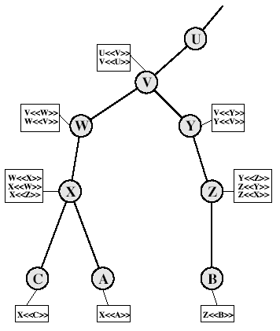
X.509 CA Hierarchy
A acquires B certificate using chain:
X<<W>>W<<V>>V<<Y>>Y<<Z>> Z<<B>>
B acquires A certificate using chain:
Z<<Y>>Y<<V>>V<<W>>W<<X>> X<<A>>

Slide 68
Authentication Procedures:
Three alternative authentication procedures:
  One-Way Authentication
  Two-Way Authentication
  Three-Way Authentication
All use public-key signatures
Akash Mehta

Slide 69
One-Way Authentication:
1 message ( A->B) used to establish
  the identity of A and that message is from A
  message was intended for B
  integrity & originality of message
A
B
1-A {ta,ra,B,sgnData,PUb[Kab]}
Ta-timestamp A=nonce B =identity
sgnData=signed with A’s private key
Akash Mehta

Slide 70
Two-Way Authentication
2 messages (A->B, B->A) which also establishes in addition:
  the identity of B and that reply is from B
  that reply is intended for A
  integrity & originality of reply
A
1-A {ta,ra,B,sgnData,KUb[Kab]}
B
2-B {tb,rb,A,sgnData,KUa[Kab]}
Akash Mehta

Slide 71
Three-Way Authentication
3 messages (A->B, B->A, A->B) which enables above authentication without synchronized clocks
1- A {ta,ra,B,sgnData,KUb[Kab]}
A
B
2 -B {tb,rb,A,sgnData,KUa[Kab]}
3- A{rb}
Akash Mehta

